Slide 1


COLLEGE CODE: 9623
​
​
COLLEGE NAME: Amrita College of Engineering and Technology​
​
DEPARTMENT: Artificial Intelligence and Data Science​
​
STUDENT NM-ID: autad0057
​
ROLL NO: 962323243057
​
DATE : ​06-10-2025
Completed the project named as Phase 5
TECHNOLOGY PROJECT NAME : Chat Application UI​
SUBMITTED BY,​
​
NAME : Suraj Singh U
​
MOBILE NO: 8072998483

Slide 2

Chat Application UI: Elevating Real-Time Communication
A comprehensive redesign focused on creating an intuitive, responsive, and feature-rich messaging experience for modern users across all devices.

Slide 3




Project Vision & Core Objectives
The Challenge
Our Solution
Existing chat interfaces suffer from cluttered layouts, poor navigation, and sluggish responsiveness. Users struggle with inconsistent experiences across devices, making seamless communication difficult.
A modern, user-centric redesign that prioritizes real-time interaction, clean aesthetics, and cross-platform consistency. We're transforming how users connect and communicate.
Intuitive Design
Real-Time Speed
Streamlined interface that users understand instantly
Instant messaging with zero lag or delays
Cross-Platform
Secure & Private
Seamless experience on mobile, tablet, and desktop
Enterprise-grade authentication and data protection

Slide 4

Who Benefits From This Solution
Individual Users
Stay connected with friends and family through effortless messaging, multimedia sharing, and instant notifications that keep conversations flowing naturally.
Students & Educators
Collaborate on projects, share resources, and maintain group discussions with organized chat threads and efficient search capabilities.
Professional Teams
Streamline workplace communication with group chats, file sharing, and real-time updates that boost productivity and reduce email overload.
Support Teams
Deliver exceptional customer service with typing indicators, message status tracking, and persistent conversation history for context-aware support.

Slide 5

Technology Stack & Architecture
Frontend Excellence
Html CSS JS power our responsive interface, delivering native-like performance with smooth animations and adaptive layouts that work beautifully across all screen sizes.
Backend Infrastructure
Express provide robust, scalable backend services. handles Express real-time data synchronization while Node.js manages complex business logic and API integrations.
Data Management
Local Storage ensure efficient data storage with flexible document structures, enabling fast queries and reliable message persistence across sessions.

Slide 6
Core Features That Transform Communication
Secure Authentication
Real-Time Messaging
Live Typing Indicators
See when others are composing messages, creating natural conversation flow and reducing wait anxiety.
Multi-factor login with email and social accounts ensures only authorized users access conversations.
Instant message delivery powered by Firebase Realtime Database creates truly live conversations.
Smart Notifications
Group Chat Functionality
Message Status Tracking
Firebase Cloud Messaging delivers instant alerts even when the app runs in the background.
Create and manage group conversations with multiple participants, perfect for teams and families.
Clear indicators show when messages are sent, delivered, and read, eliminating communication uncertainty.

Slide 7





Development Methodology & Process
Requirement Analysis
Identified user pain points and defined success metrics through interviews and competitive analysis.
UI/UX Design
Created wireframes and interactive prototypes focused on usability, accessibility, and visual appeal.
Development
Built frontend and backend using agile sprints, integrating Firebase and implementing responsive layouts.
Testing & QA
Conducted comprehensive unit, integration, and end-to-end testing using Jest and Cypress frameworks.
Deployment
Launched on Firebase hosting with GitHub integration for continuous deployment and version control.

Slide 8
Overcoming Technical Challenges
1
2
Real-Time Data Synchronization
Responsive Layout Complexity
Challenge: Maintaining consistent message state across multiple devices simultaneously.
Challenge: Ensuring pixel-perfect layouts across dozens of device sizes and orientations.
Solution: Implemented Firebase Realtime Database and WebSockets for instant, bidirectional updates with automatic conflict resolution.
Solution: Adopted adaptive CSS and Flutter's flexible layout system with extensive device testing protocols.
3
4
Authentication Reliability
Notification Delivery
Challenge: Securing user access while maintaining seamless login experiences.
Challenge: Ensuring timely message alerts across different network conditions.
Solution: Integrated Firebase Authentication with OAuth providers for robust, user-friendly security.
Solution: Leveraged Firebase Cloud Messaging for reliable push notifications with offline queueing.
5
6
Data Structure Optimization
Testing Coverage
Challenge: Managing growing message history without performance degradation.
Challenge: Validating complex real-time interactions and edge cases.
Solution: Designed efficient Firestore collections with pagination and strategic indexing for fast queries.
Solution: Established comprehensive testing suite with Jest for unit tests and Cypress for end-to-end workflows.

Slide 9
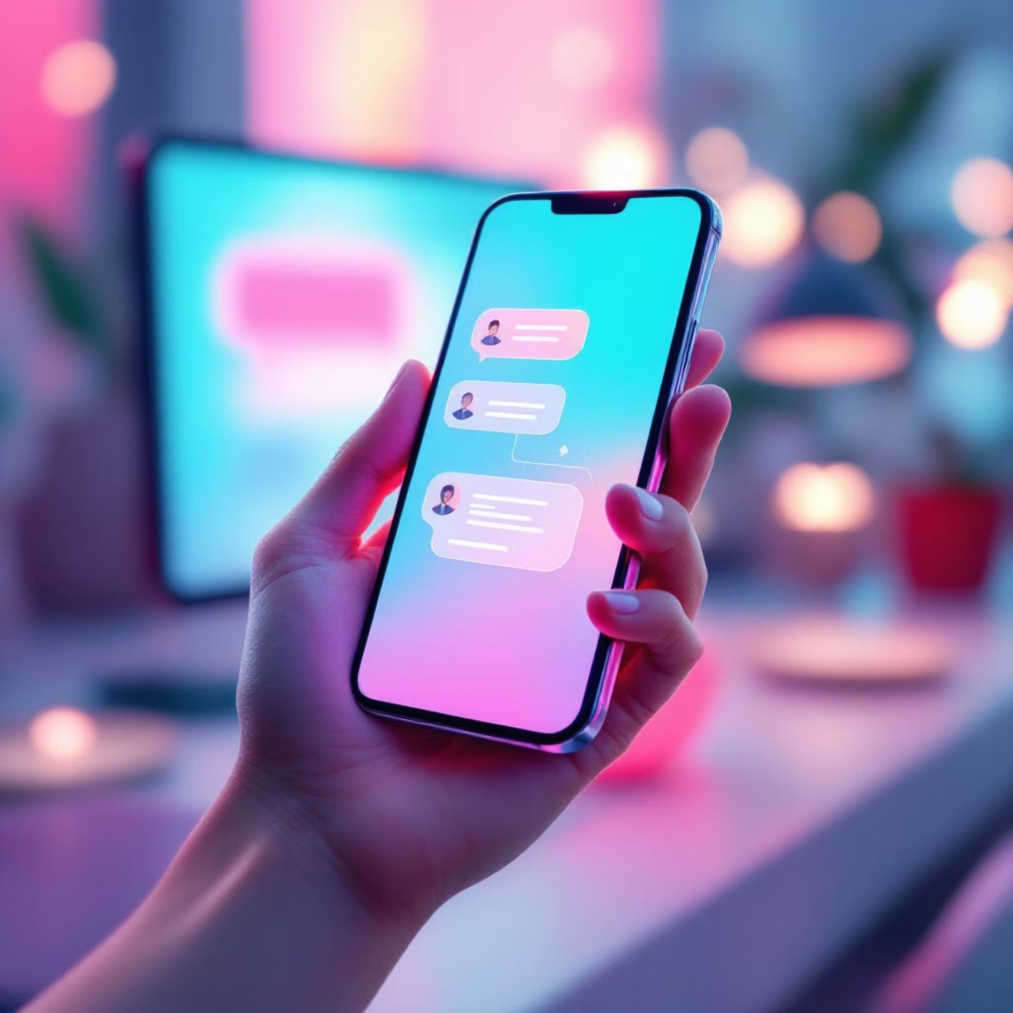
Project Outcomes & Impact
A New Standard in Chat Experiences
We've successfully delivered a responsive, efficient, and visually stunning chat interface that fundamentally enhances how users communicate in real-time.
The application seamlessly handles messaging across devices, providing instant updates, clear status indicators, and an intuitive interface that users love. Early feedback shows significant improvements in user engagement and satisfaction.
100%
<100ms
24/7
Cross-Device Compatibility
Message Latency
Reliable Notifications
Flawless experience on mobile, tablet, and desktop
Near-instantaneous real-time delivery
Always-on push alerts keep users connected
Looking Forward: This foundation enables future enhancements including voice/video calls, advanced search, message encryption, and AI-powered features that will continue elevating the user experience.

Slide 10
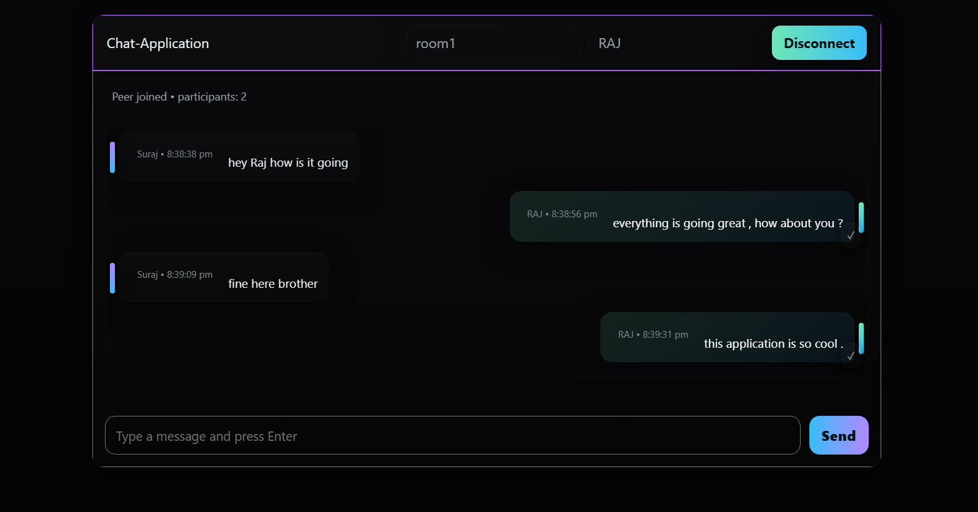
Chat Applications UI Prototype
GitHub Repo Link – Chat Application
Chat Applications UI Prototype

